Slide 1

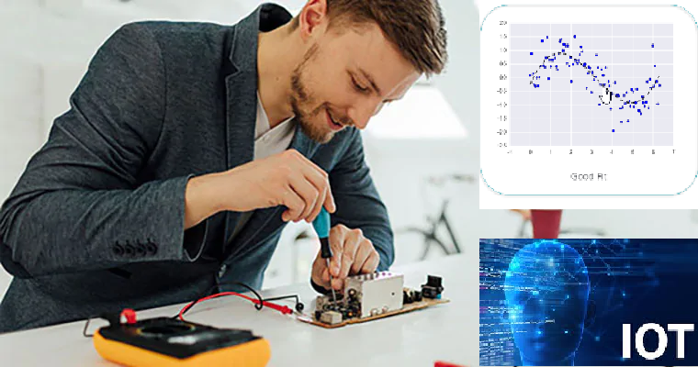



Wearable Devices and Computer Vision
Monday, July 13, 2020
Head Instructor: Jose Luis Ramirez Herran
TA’s: Souleymane Konate and Ricardo Villamil

Slide 2
Summary 1->6
Lecture 1. Students are getting the hardware while we Get started with the Sensor Tile development
Lecture 2. Introduce the basic signal processing concepts
Lecture 3. Introduce image processing – basic image operations
Lecture 4.
Tutorial 1 Troubleshooting
Introduction to Machine Learning and Human Activity Recognition
Numpy, Pandas, Matplotlib and Scikit learn.
Lecture 5. Regression
Lecture 6. Support Vector Machine Classification and PCA
Implementation of SVM in Python
Human Activity Classification Example: Optimizing of the Number and Placements of Wearable IMUs for Automatic Rehabilitation Recording
Today’s Class:
Souleymane will us teach about:
Linear Systems in DSP
Impulse Function
Convolution
Low and High Pass Filter
Fourier and FFT
Ricardo is presenting some recent MIT MediaLab’s projects on Wearable Devices
Project Teams and Proposals

Slide 3
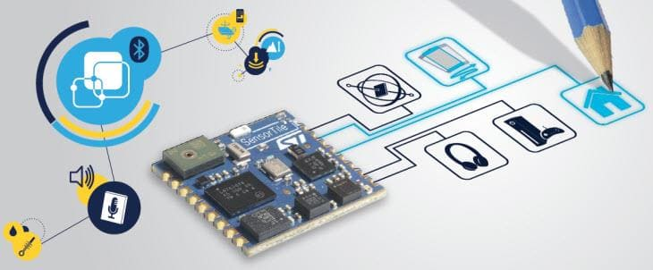
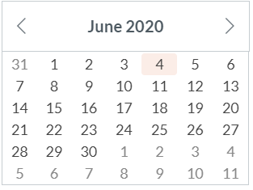
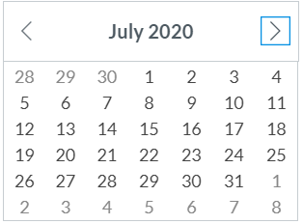
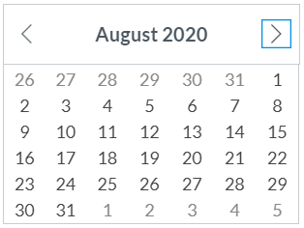
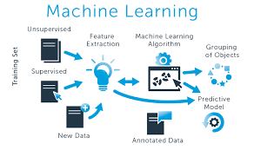
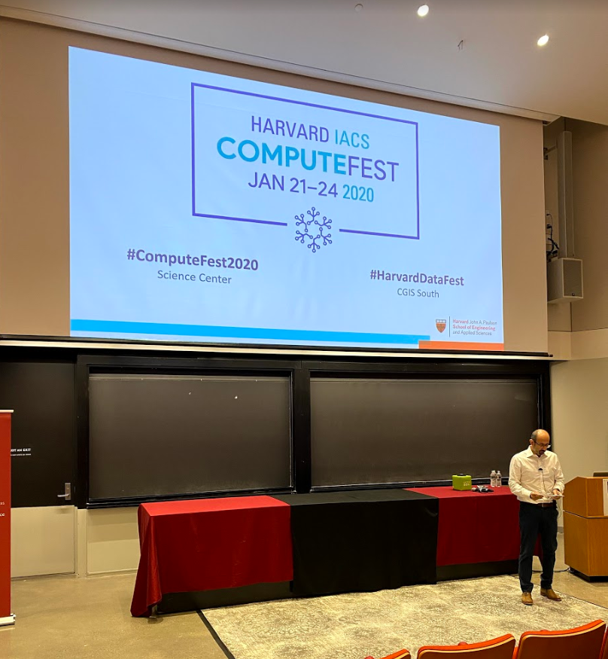
Calendar summer 2020
Mondays and Wednesdays 6:30 pm – 9:30 pm
Wearable Devices and Computer Vision
Lecture 6
Project
presentations
Su M Tu W Th F S
SW+HW Setup.+ Basic Tutorials

Slide 4
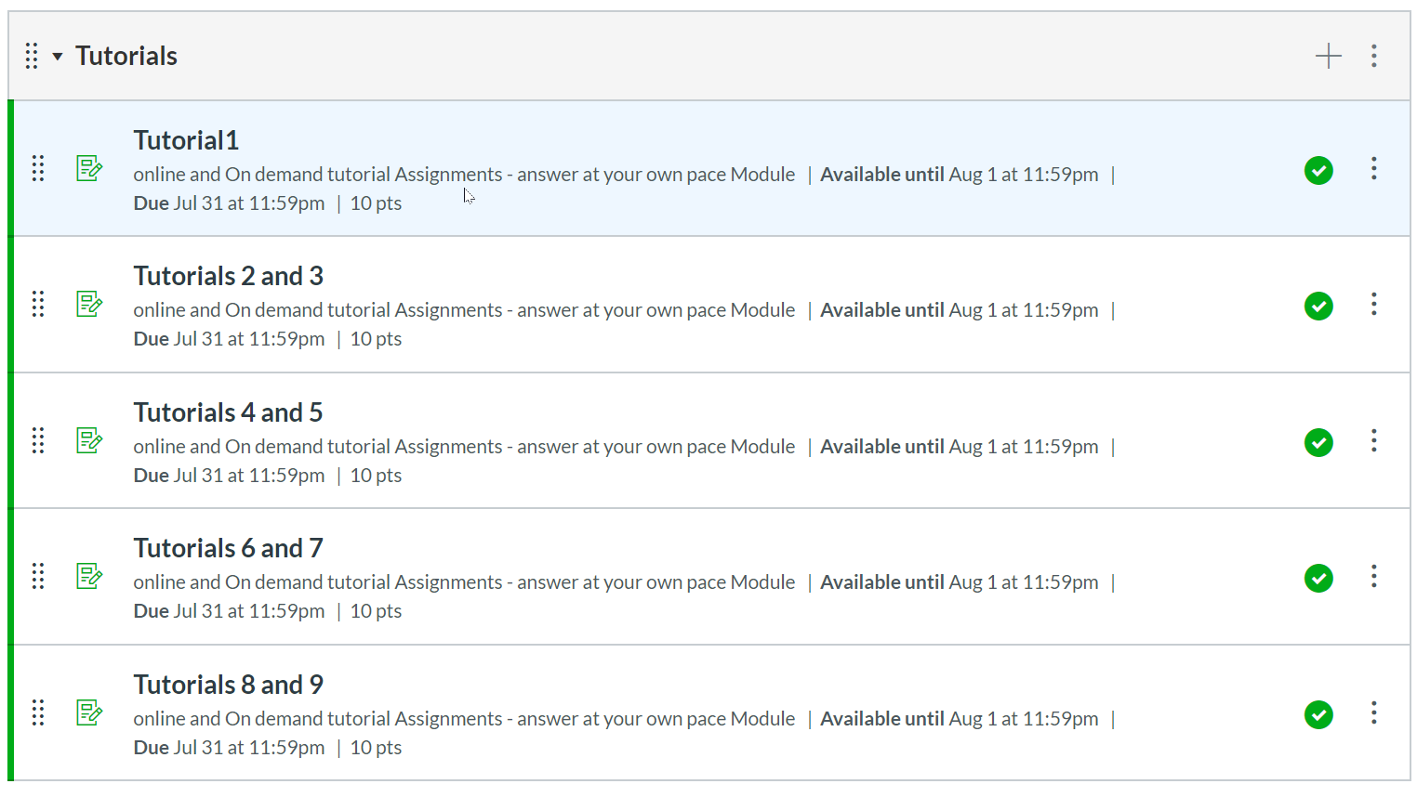
Tutorials

Slide 5
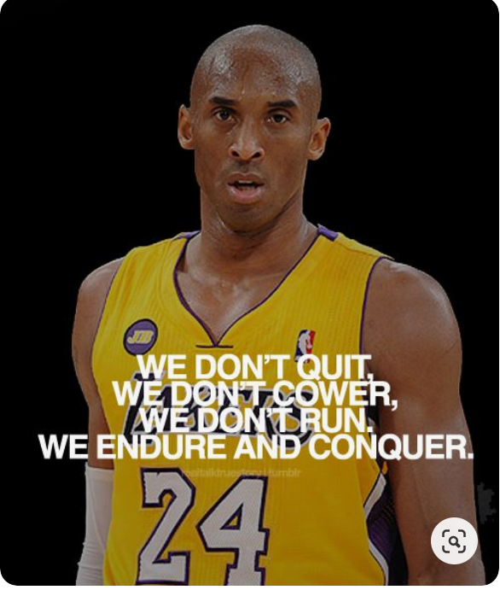
Today’s Lecture
Break
8:00 pm – 8:10 pm
Break
9:00 pm – 9:10 pm
Part 1
Part 2
MIT MediaLab’s projects by Ricardo
Part 3
Questions?
Projects and Teams
Summary
Digital Signal Processing :Advanced tools by Souleymane Konate
8:10 pm – 9:00 pm
6:30 pm – 8:00 pm
9:10 pm – 9:30 pm

Slide 6
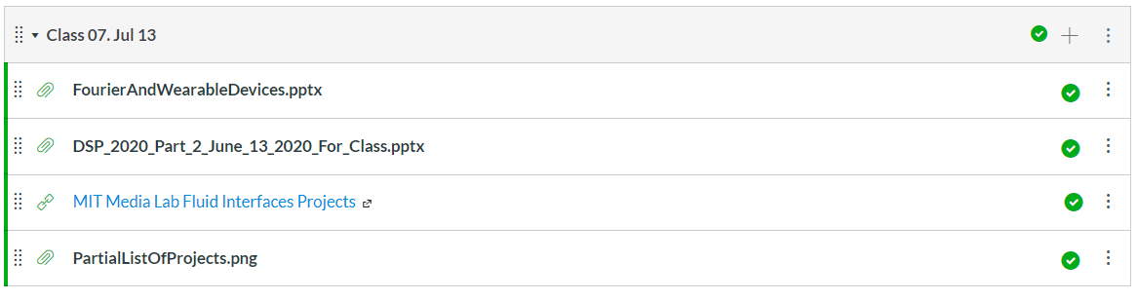
Presentation and Jupyter notebooks for SVM
Ricardo
Jose
Souleymane
All

Slide 7
Break
8:10 pm – 8:20 pm
6:30 pm – 8:10 pm
Part 1
Summary
Digital Signal Processing :Advanced tools by Souleymane Konate

Slide 8
Today’s Lecture
Break
8:00 pm – 8:10 pm
Break
8:40 pm – 8:50 pm
Part 1
Part 2
MIT MediaLab’s projects by Ricardo
Part 3
Questions?
Projects and Teams
Summary
Regression Algorithms by Souleymane Konate
6:30 pm – 8:00 pm
8:10 pm – 9:00 pm
9:00 pm – 9:30 pm

Slide 9
Today’s Lecture
Break
7:40 pm – 7:50 pm
Break
8:40 pm – 8:50 pm
Part 1
Part 2
Python for:
Linear and Logistic Regression using Python
Questions
Part 3
Projects and Teams
Questions?
Summary
Regression Algorithms by Souleymane Konate
6:30 pm – 7:50 pm
7:50 pm – 8:40 pm
8:50 pm – 9:30 pm

Slide 10
Troubleshooting tutorials in canvas
We have very effective office hours so far and we can show some videos were we solved specific problems related with the tutorials. Please take a look in Canvas and we hope this videos help you to get started with the sensorTile curriculum. They will be published into the canvas modules.
Piazza

Slide 11
Office hours
emails TA's:
sok462@g.harvard.edu
ricardo_villamil@fas.harvard.edu
Calendly me:
https://calendly.com/jlr682/wearable-devices-final-project

Slide 12
Questions?

